Slide 1


Website for Common Grounds Coffee Shop
By Begimai Alisherova

Slide 2
Website Structure
Home Page
01
About us
02
Contact us
03

Slide 3
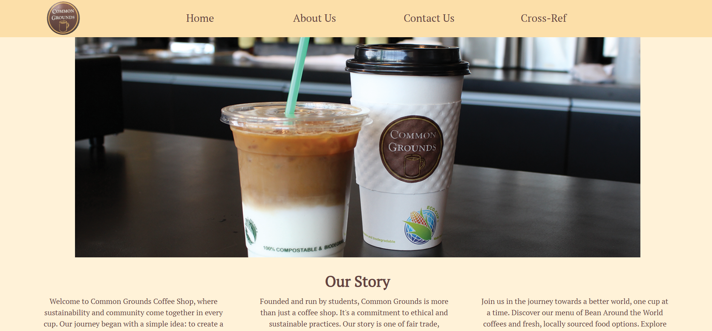
HOME PAGE

Slide 4
HOME PAGE
Fixed Navigation Bar
Static Image

Slide 5
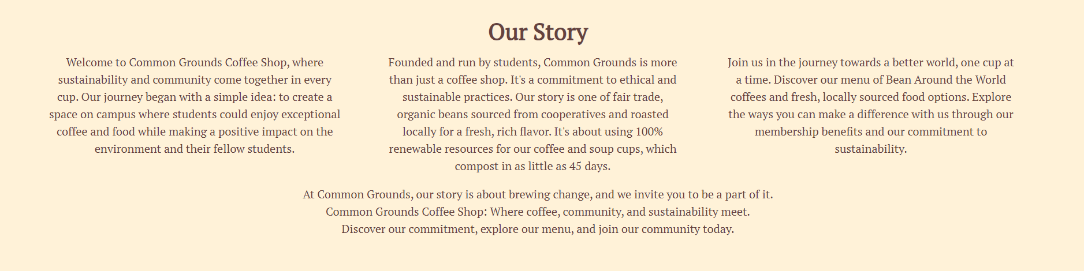
HOME PAGE
Float Layout
Using 3 sections
3 stylesheets connected

Slide 6
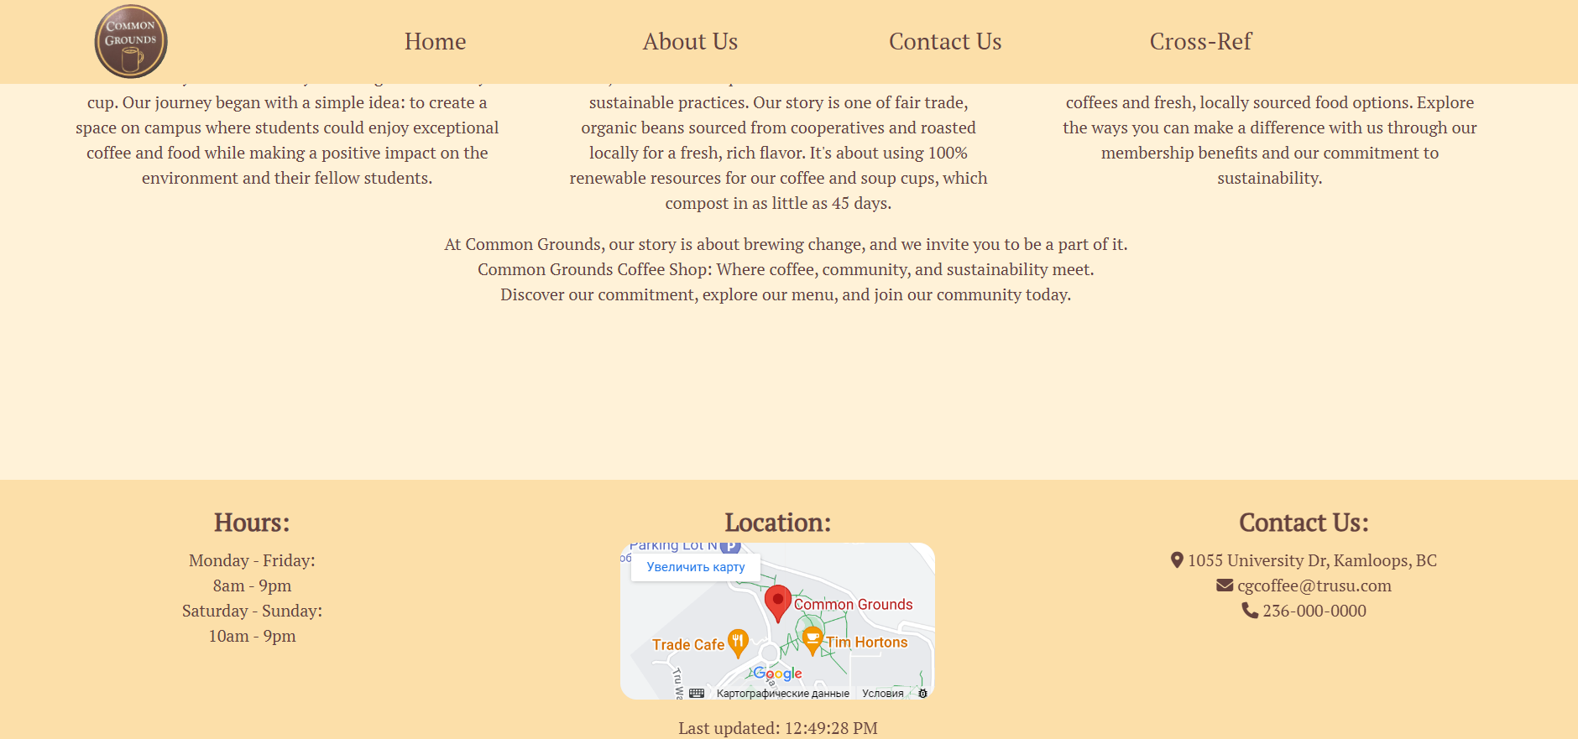
HOME PAGE
Footer
Icons
Last updated + Location from Google Maps

Slide 7
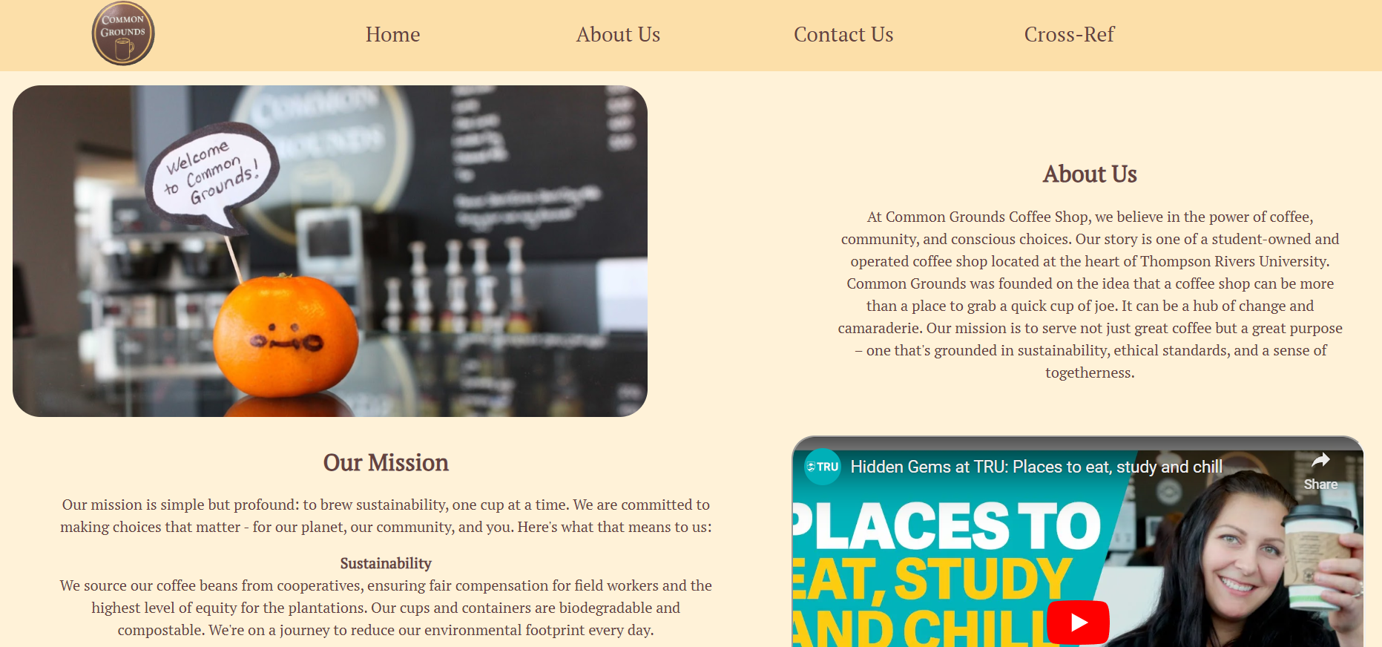
ABOUT US PAGE

Slide 8
ABOUT US PAGE
Clickable Image
Grid Layout
Animation

Slide 9
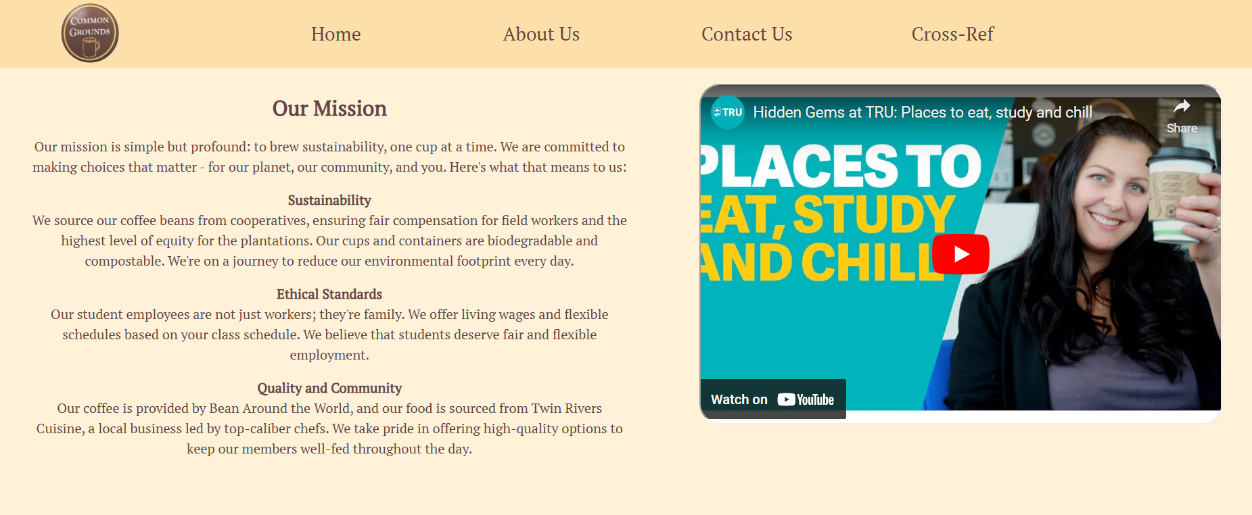
ABOUT US PAGE
Fixed Navigation Bar
Video
Company’s Mission

Slide 10
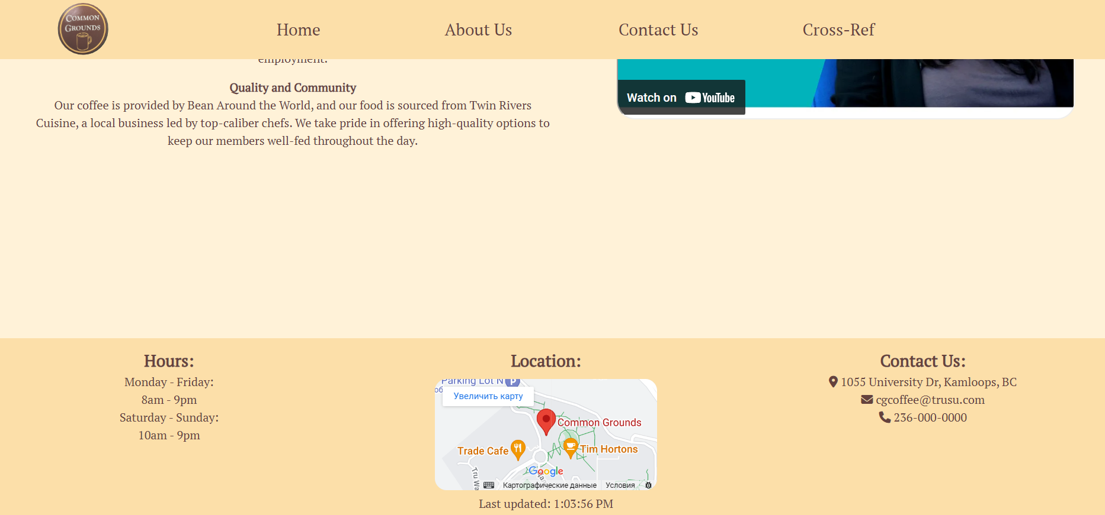
ABOUT US PAGE
Footer
Icons
Last updated + Location from Google Maps

Slide 11
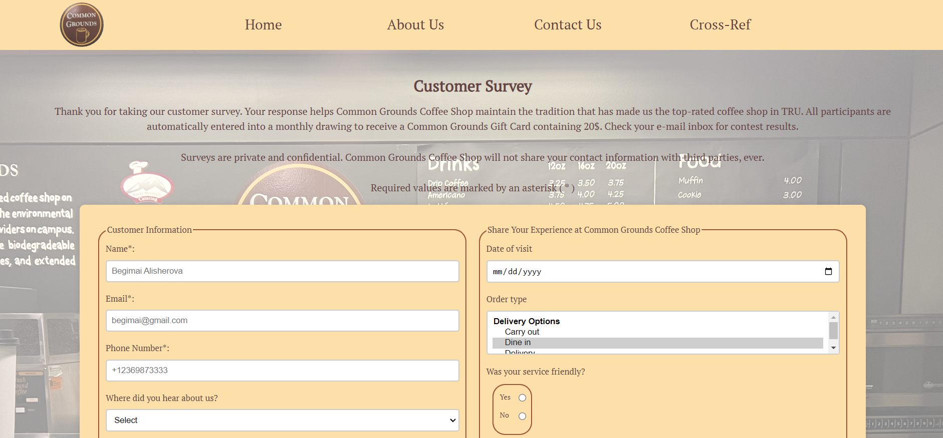
CONTACT US PAGE

Slide 12
CONTACT US PAGE
Clickable Image
Background Image
Form

Slide 13
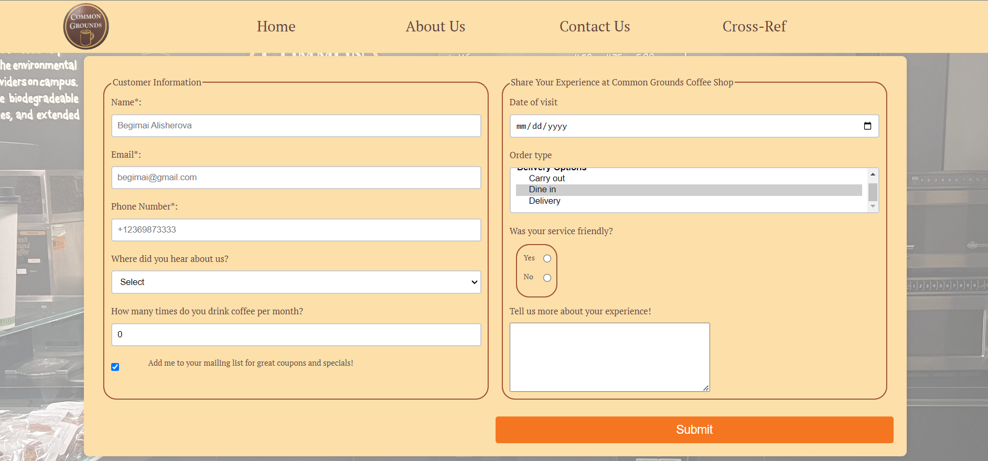
CONTACT US PAGE
Form features:
Selection list
Calendar
Checkbox
Buttons
Textarea
+ Validation

Slide 14
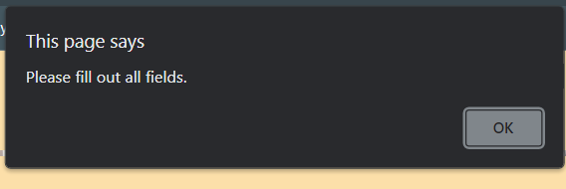
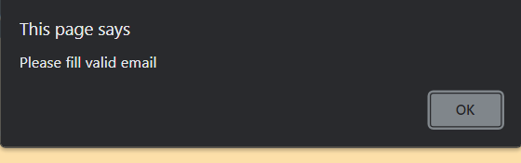
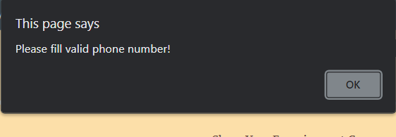
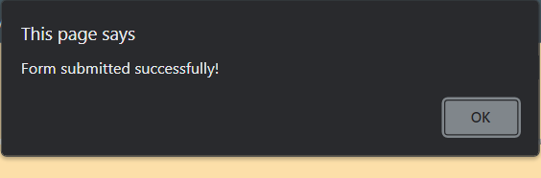
CONTACT US PAGE
Form features:
Selection list
Calendar
Checkbox
Buttons
Textarea
+ Validation

Slide 15
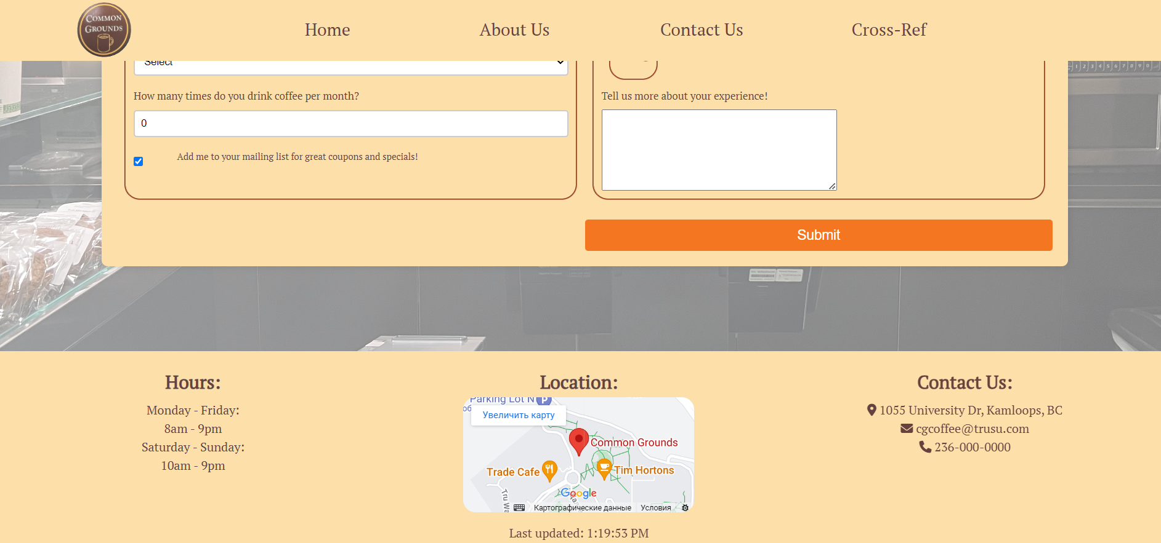
CONTACT US PAGE
Footer
Icons
Last updated + Location from Google Maps

Slide 16
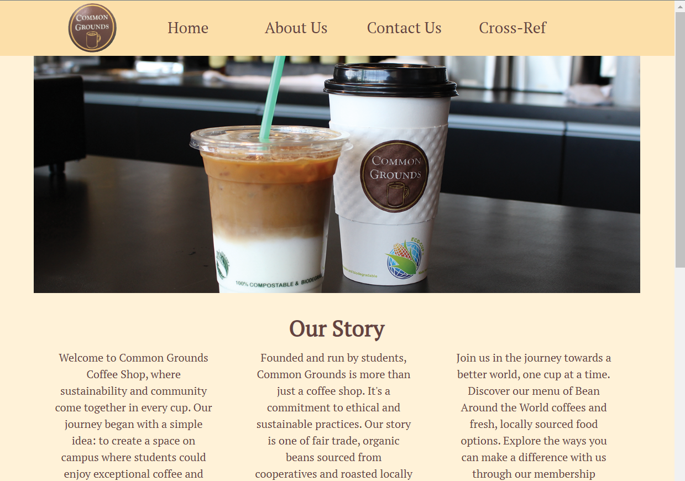
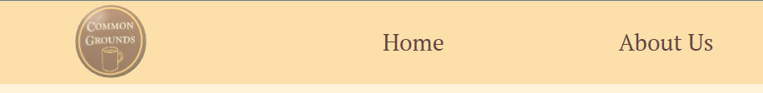
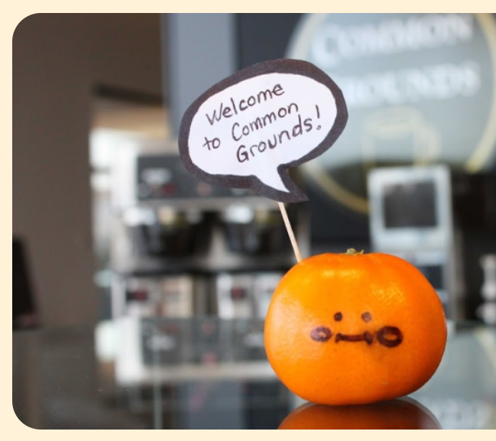
Some Other Features

Slide 17
Thanks for attention!

